Slide 1
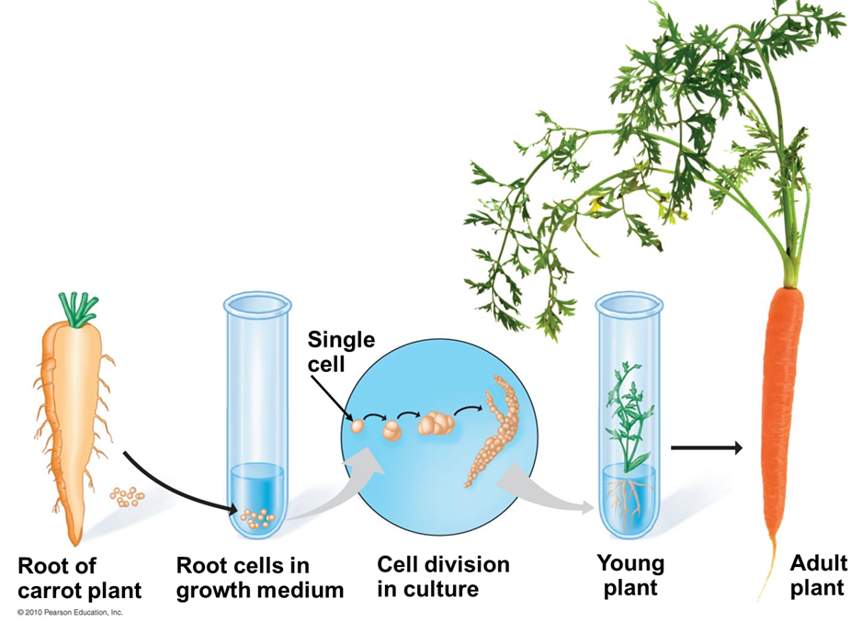
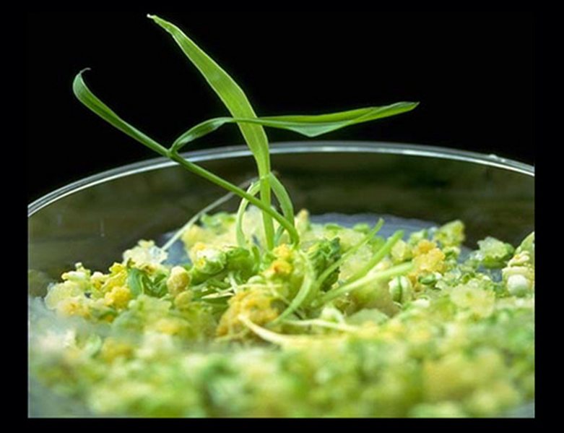
PLANT Tissue Culture
Plant Tissue Culture

Slide 2
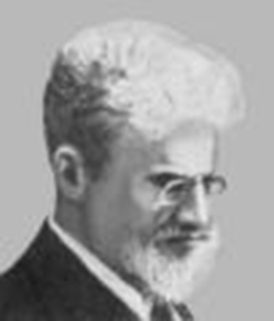
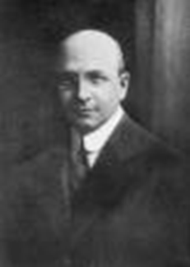
What’s the Background?
Tissue culture had its origins at the beginning of the 20th century with the work of Gottleib Haberlandt (plants) and Alexis Carrel (animals)
Haberlandt Carrel

Slide 3
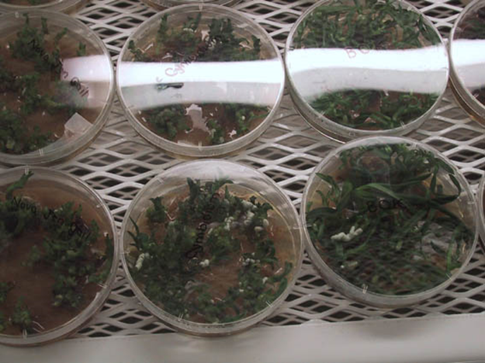
The first commercial use of plant clonal propagation on artificial media was in the germination and growth of orchid plants, in the 1920’s
In the 1950’s and 60’s there was a great deal of research, but it was only after the development of a reliable artificial medium (Murashige & Skoog, 1962) that plant tissue culture really ‘took off’ commercially

Slide 4
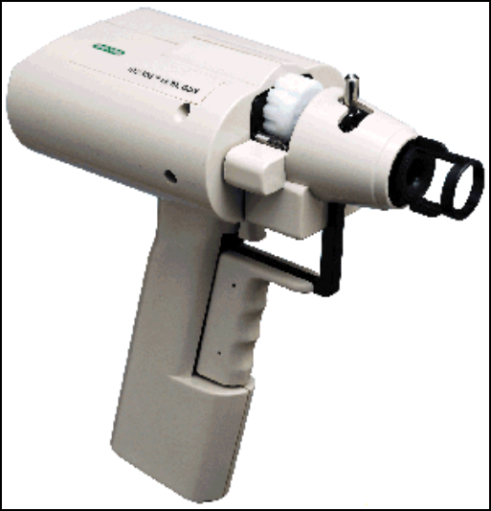
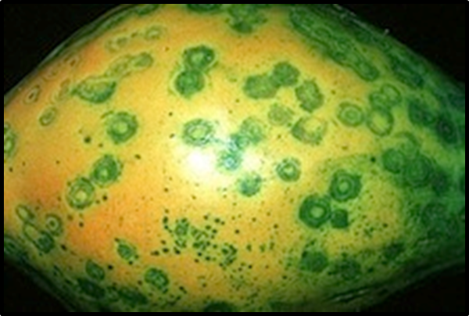
A more recent advance is the use of plant and animal tissue culture along with genetic modification using viral and bacterial vectors and gene guns to create genetically engineered organisms
https://www.youtube.com/watch?v=2G-yUuiqIZ0
https://www.youtube.com/watch?v=cK-OGB1_ELE

Slide 5
What is needed? Tissue culture, both plant and animal has several critical requirements:
Appropriate tissue (some tissues culture better than others)
A suitable growth medium containing energy sources and inorganic salts to supply cell growth needs. This can be liquid or semisolid
Aseptic (sterile) conditions, as microorganisms grow much more quickly than plant and animal tissue and can over run a culture

Slide 6
Plant Tissue Culture
The culture and maintenance of plant cells and organs
The culture of plant seeds, organs, tissues, cells, or protoplasts on nutrient media under sterile conditions
The growth and development of plant seeds, organs, tissues, cells or protoplasts on nutrient media under sterile (axenic) conditions
The in vitro, aseptic plant culture for any purpose including genetic transformation and other plant breeding objectives, secondary product production, pathogen elimination or for asexual (micropropagation) or sexual propagation
Notes:
Additional Points: Growth of plant cells outside of an intact plant
A technique essential to many areas of plant science
Culture of individual or groups of cells and whole organs contribute to the understanding of both fundamental and applied science
Cultures can be sustained and maintained as a mass of undifferentiated cells for an extended period of time or regenerated into whole plants

Slide 7
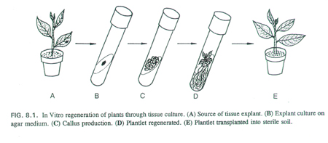

Slide 8
Why?
The production of plants in sterile containers reduces disease transmission
Allows production of plants from seeds that otherwise have very low chances of germinating and growing, i.e.: orchids and Nepenthes.
To clean particular plants of viral and other infections and to quickly multiply these plants as 'cleaned stock' for horticulture and agriculture.

Slide 9
Why?
The production of clones of plants that produce particularly good flowers, fruits, or have other desirable traits.
To quickly produce mature plants.
The production of multiples of plants in the absence of seeds or necessary pollinators to produce seeds.
The regeneration of whole plants from plant cells that have been genetically modified.

Slide 10
Important Factors
Growth Media
Minerals, Growth factors, Carbon source, Hormones
Environmental Factors
Light, Temperature, Photoperiod, Sterility, Media
Explant Source
Usually, the younger, less differentiated explant, the better for tissue culture
Different species show differences in amenability to tissue culture
In many cases, different genotypes within a species will have variable responses to tissue culture; response to somatic embryogenesis has been transferred between melon cultivars through sexual hybridization
Notes:
Emphasize the implications for genetic involvement: Could there be undesirable genes linked to genes influencing tissue culture response?

Slide 11
Basis for Plant Tissue Culture
Two Hormones Affect Plant Differentiation:
Auxin: Stimulates Root Development
Cytokinin: Stimulates Shoot Development
Generally, the ratio of these two hormones can determine plant development:
↑ Auxin ↓Cytokinin = Root Development
↑ Cytokinin ↓Auxin = Shoot Development
Auxin = Cytokinin = Callus Development

Slide 12
Hormone
Product Name
Function in Plant Tissue Culture
Auxins
Indole-3-Acetic Acid
Indole-3-Butyric Acid
Indole-3-Butyric Acid, Potassium Salt
α-Naphthaleneacetic Acid
2,4-Dichlorophenoxyacetic Acid
p-Chlorophenoxyacetic acid
Picloram
Dicamba
Adventitous root formation (high concen)
Adventitious shoot formation (low concen)
Induction of somatic embryos
Cell Division
Callus formation and growth
Inhibition of axillary buds
Inhibition of root elongation
Cytokinins
6-Benzylaminopurine
6-γ,γ-Dimethylallylaminopurine (2iP)
Kinetin
Thidiazuron (TDZ)
N-(2-chloro-4-pyridyl)-N’Phenylurea
Zeatin
Zeatin Riboside
Adventitious shoot formation
Inhibition of root formation
Promotes cell division
Modulates callus initiation and growth
Stimulation of axillary’s bud breaking and growth
Inhibition of shoot elongation
Inhibition of leaf senescence
Gibberellins
Gibberellic Acid
Stimulates shoot elongation
Release seeds, embryos, and apical buds from dormancy
Inhibits adventitious root formation
Paclobutrazol and ancymidol inhibit gibberellin synthesis thus resulting in shorter shoots, and promoting tuber, corm, and bulb formation.
Abscisic Acid
Abscisic Acid
Stimulates bulb and tuber formation
Stimulates the maturation of embryos
Promotes the start of dormancy
Polyamines
Putrescine
Spermidine
Promotes adventitious root formation
Promotes somatic embryogenesis
Promotes shoot formation

Slide 13
Control of in vitro culture
Cytokinin
Leaf strip
Adventitious
Shoot
Root
Callus
Auxin

Slide 14
Characteristic of Plant
Tissue Culture Techniques
Environmental condition optimized (nutrition, light, temperature).
Ability to give rise to callus, embryos, adventitious roots and shoots.
Ability to grow as single cells (protoplasts, microspores, suspension cultures).
Plant cells are totipotent, able to regenerate a whole plant.

Slide 15
Medium constituents
Inorganic salt formulations
Source of carbohydrate
Vitamins
Water
Plant hormones - auxins, cytokinins, GA’s
Solidifying agents

Slide 16
Macronutrient salts Function of nutrients in plant growth
Nitrogen – Influences plant growth rate, essential in plant nucleic acids (DNA), proteins, chlorophyll, amino acids, and hormones.
Phosphorus – Abundent in meristimatic and fast growing tissue, essential in photosynthesis, respiration,
Potassium – Necessary for cell division, meristematic tissue, helps in the pathways for carbohydrate, protein and chlorophyll synthesis.

Slide 17
Macro-nutrient salts
NH4NO3 Ammonium nitrate
KNO3 Potassium nitrate
CaCl2 -2 H2O Calcium chloride (Anhydrous)
MgSO4 -7 H2O Magnesium sulfide (Epsom Salts)
KH2PO4 Potassium hypophosphate
FeNaEDTA Fe/Na ethylene-diamine-tetra acetate
H3BO3 Boric Acid
MnSO4 - 4 H2O Manganese sulfate
ZnSO4 - 7 H2O Zinc sulfate
KI Potassium iodide
Na2MoO4- 2 H2O Sodium molybdate
CuSO4 - 5 H2O Cupric sulfate
CoCl2 - H2O Cobaltous sulfide

Slide 18
Macronutrient salts Function of nutrients in plant growth
Calcium:
cell walls and root and leaf development.
Participates in translocation of sugars, amino acids, and ties up oxalic acid (toxin)
Iron:
respiration , chlorophyll synthesis and photosynthesis.
FeNaEDTA = sodium salt of EDTA sequesters iron, making it available to plants.
Manganese:
regulation of enzymes and growth hormones.
Assists in photosynthesis and respiration.
Magnesium:
photosynthetic and respiration system.
Active in uptake of phosphate
translocation of phosphate and starches.
Sulfur:
formation of nodules and chlorophyll synthesis, structural component of amino acids and Proteins

Slide 19
Macronutrient salts Function of nutrients in plant growth
Molybdenum :
Involved in enzymatic reduction of nitrates to ammonia.
Assists in conversion of inorganic phosphate to organic form.
Zinc:
Involved in production of growth hormones and chlorophyll.
Active in respiration and carbohydrate synthesis.
Boron:
Involved in production of growth hormones and chlorophyll.
Active in respiration and carbohydrate synthesis.
Copper:
Involved in photosynthetic and respiration systems.
Assists chlorophyll synthesis and used as reaction catalyst.

Slide 20
Carbohydrates
Plants in culture usually cannot meet their needs for fixed carbon. Usually added as sucrose at 2-3% w/v.
Glucose or a mixture of glucose and fructose is occasionally used.
For large scale cultures, cheaper sources of sugars (corn syrup) may be used.

Slide 21
Photoautotrophic culture
Growth without a carbon source. Therefore need to boost photosynthesis.
High light intensities needed (90-150mMole/m²/s) compared to normal (30-50).
Usually increase CO₂ (1000ppm) compared to normal 369.4ppm.
Much reduced level of contamination and plants are easier to transfer to the greenhouse.

Slide 22
Inorganic salt formulations
Contain a wide range of Macro-elements (>mg/l) and microelements (<mg/l).
A wide range of media are readily available as spray-dried powders.
Murashige and Skoog Medium (MS)(1965) is the most popular for shoot cultures.
Gamborgs B5 medium is widely used for cell suspension cultures (no ammonium).

Slide 23
Vitamins
A wide range of vitamins are available and may be used.
Generally, the smaller the explant, the more exacting the vitamin requirement.
A vitamin cocktail is often used (Nicotinic acid, glycine, Thiamine, pyridoxine).
Inositol usually has to be supplied at much higher concentration (100mg/l)

Slide 24
Three Fundamental Abilities of Plants
Totipotency
The potential or inherent capacity of a plant cell to develop into an entire plant if suitably stimulated.
It implies that all the information necessary for growth and reproduction of the organism is contained in the cell
Dedifferentiation
Capacity of mature cells to return to meristematic condition and development of a new growing point, follow by redifferentiation which is the ability to reorganize into new organ
Competency
The endogenous potential of a given cells or tissue to develop in a particular way

Slide 25
Why is tissue culture important?
Plant tissue culture has value in studies such as cell biology, genetics, biochemistry, and many other research areas
Crop Improvement
Seed Production – Plant Propagation Technique
Genetic material conservation
Notes:
25

Slide 26
Types of In Vitro Culture (explant based)
Culture of intact plants (seed and seedling culture)
Embryo culture (immature embryo culture)
Organ culture
Callus culture
Cell suspension culture
Protoplast culture

Slide 27
Seed culture
Growing seed aseptically in vitro on artificial media
Increasing efficiency of germination of seeds that are difficult to germinate in vivo
Precocious germination by application of plant growth regulators
Production of clean seedlings for explants or meristem culture

Slide 28
Embryo culture
Growing embryo aseptically in vitro on artificial nutrient media
It is developed from the need to rescue embryos (embryo rescue) from wide crosses where fertilization occurred, but embryo development did not occur
It has been further developed for the production of plants from embryos developed by non-sexual methods (haploid production discussed later)
Overcoming embryo abortion due to incompatibility barriers
Overcoming seed dormancy and self-sterility of seeds
Shortening of breeding cycle

Slide 29
Organ culture
Any plant organ can serve as an explant to initiate cultures
No. | Organ | Culture types
1. | Shoot | Shoot tip culture
2. | Root | Root culture
3. | Leaf | Leaf culture
4. | Flower | Anther/ovary culture

Slide 30
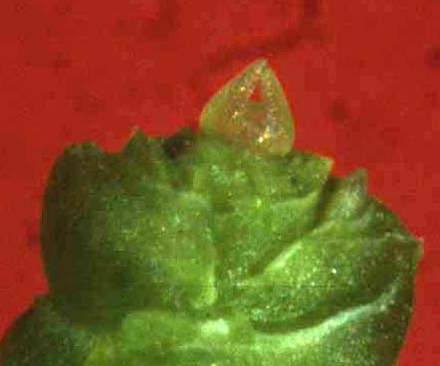
Shoot apical meristem culture
Production of virus free germplasm
Mass production of desirable genotypes
Facilitation of exchange between locations (production of clean material)
Cryopreservation (cold storage) or in vitro conservation of germplasm

Slide 31
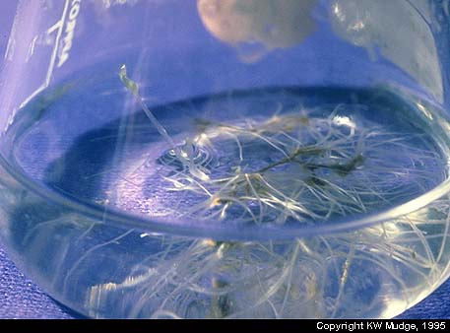
Root organ culture

Slide 32
Ovary or ovule culture
Production of haploid plants
A common explant for the initiation of somatic embryogenic cultures
Overcoming abortion of embryos of wide hybrids at very early stages of development due to incompatibility barriers
In vitro fertilization for the production of distant hybrids avoiding style and stigmatic incompatibility that inhibits pollen germination and pollen tube growth

Slide 33
Anther and microspore culture
Production of haploid plants
Production of homozygous diploid lines through chromosome doubling (doubled haploid (DH)), thus reducing the time required to produce inbred lines (homozygous genotypes produced by repeated selfing with selection over several generations)
Uncovering mutations or recessive phenotypes

Slide 34
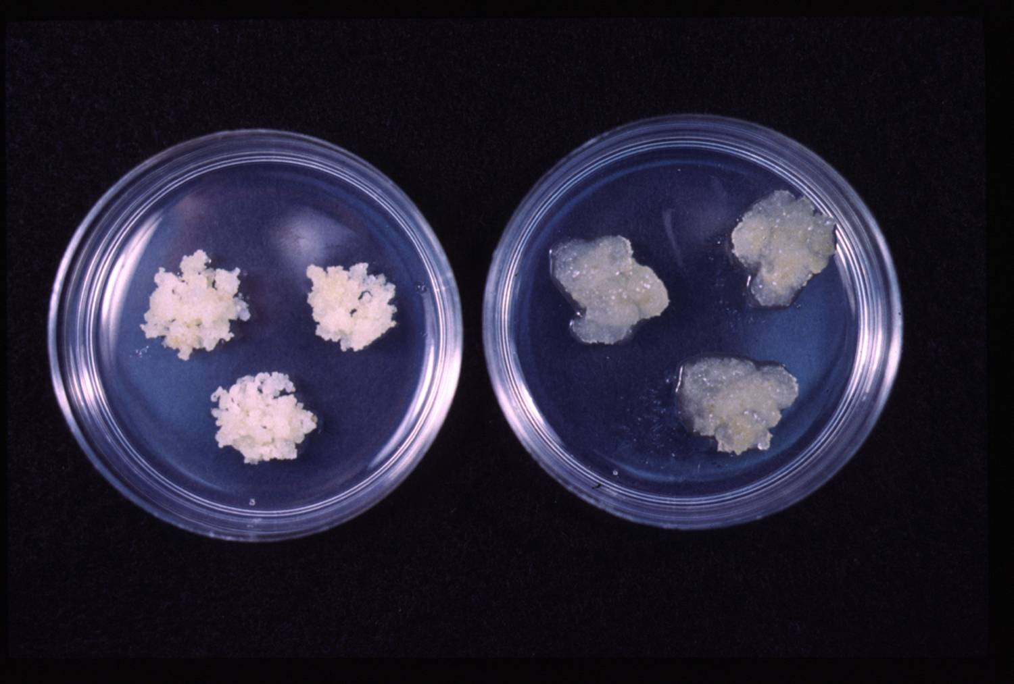
Callus Culture
Callus:
An un-organised mass of cells
A tissue that develops in response to injury caused by physical or chemical means
Most cells of which are differentiated although may be and are often highly unorganized within the tissue

Slide 35
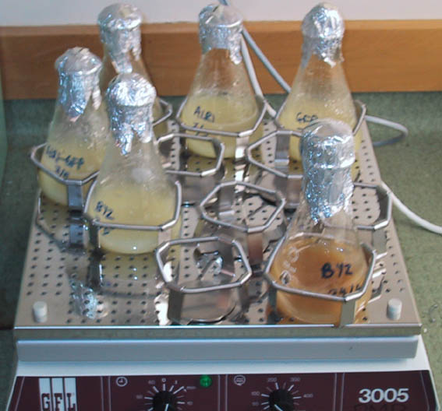
Cell suspension culture
When callus pieces are agitated in a liquid medium, they tend to break up.
Suspensions are much easier to bulk up than callus since there is no manual transfer or solid support.

Slide 36
Introduction into suspension
Sieve out lumps
1 2
Initial high
density
+
Pick off
growing
high
producers
Subculture
and sieving
Plate out

Slide 37
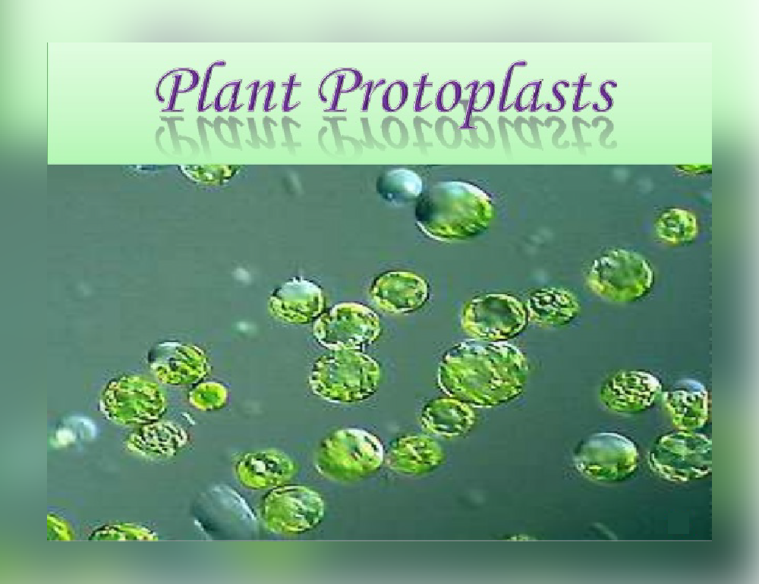
Protoplast
The living material of a plant or bacterial cell, including the protoplasm and plasma membrane after the cell wall has been removed.

Slide 38
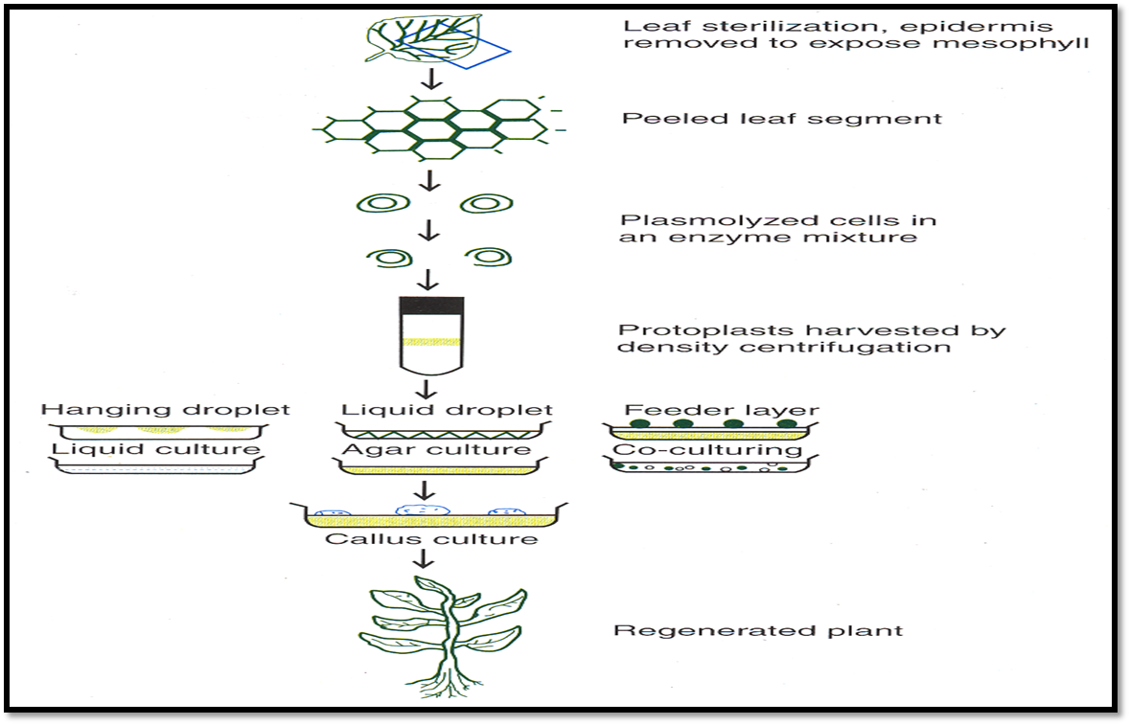

Slide 39
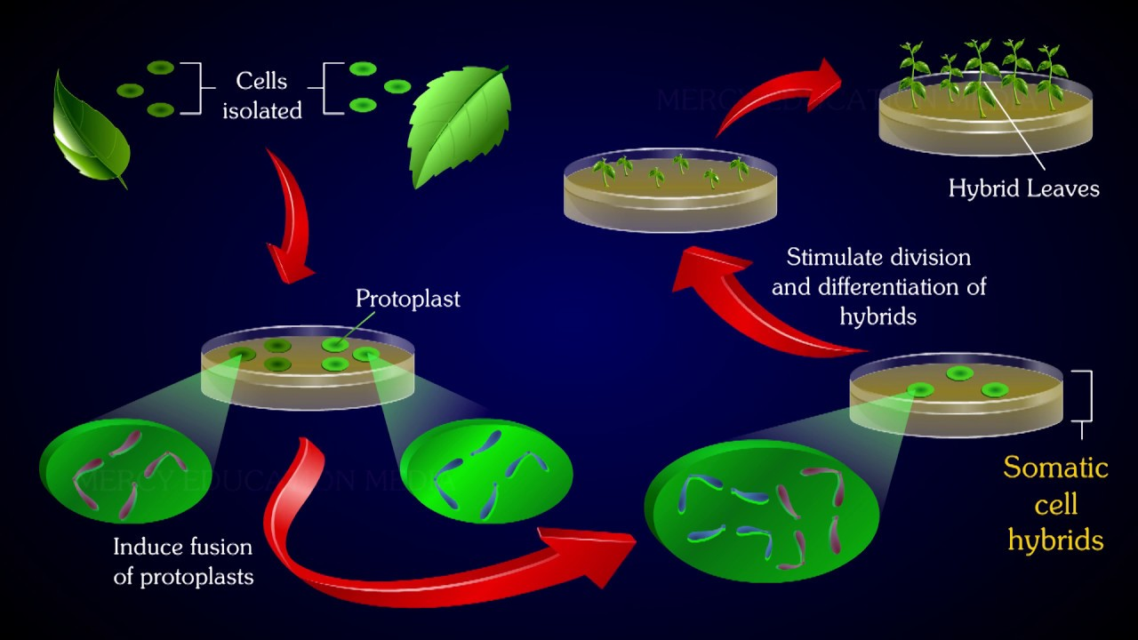

Slide 40
Plant Regeneration Pathways
Organogenesis
Relies on the production of organs either directly from an explant or callus structure
Somatic Embryogenesis
Embryo-like structures which can develop into whole plants in a way that is similar to zygotic embryos are formed from somatic cells
Existing Meristems (Microcutting)
Uses meristematic cells to regenerate whole plant.
(Source:Victor. et al., 2004)
Notes:
40

Slide 41
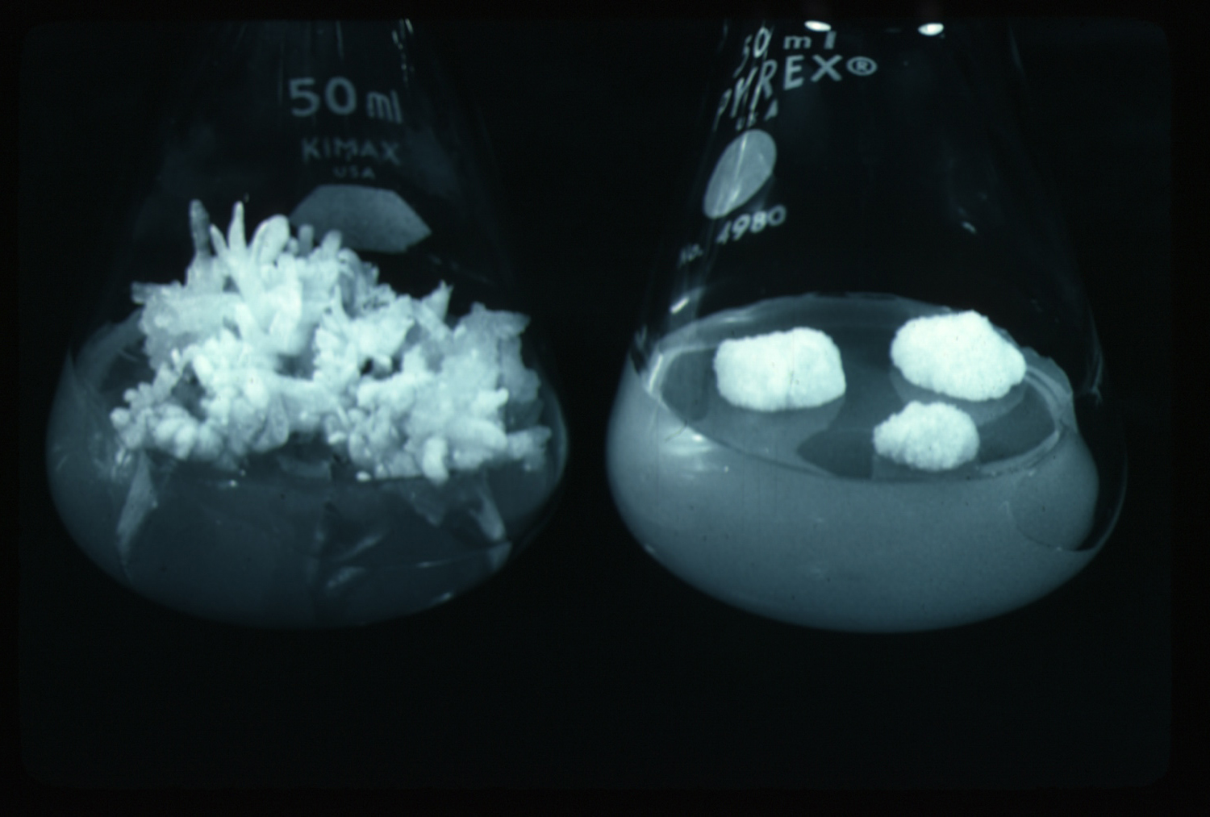
Organogenesis
The ability of non-meristematic plant tissues to form various organs de novo.
The formation of adventitious organs
The production of roots, shoots or leaves
These organs may arise out of pre-existing meristems or out of differentiated cells
This may involve a callus intermediate but often occurs without callus.

Slide 42
Steps in Organogenesis
https://www.youtube.com/watch?v=hgzU_FS59e4
https://www.youtube.com/watch?v=cD9CFtpLL2s&t=1121s
(Source:Victor. et al, 2004)
Phytohormone Perception
Dedifferentiation of differentiated cells to acquire competence.
Reentry of cells into the cell cycle
Organization of cell division to form specific organs primordia in meristem
Notes:
42

Slide 43
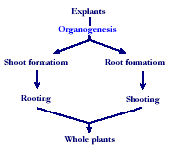

Slide 44
Indirect organogenesis
Explant → Callus → Meristemoid → Primordium
Dedifferentiation
Less committed,
More plastic developmental state
Induction
Cells become organogenically competent and fully determined for primordia production
Differentiation

Slide 45
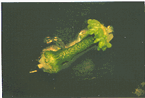
Direct Organogenesis
Direct shoot/root formation from the explant

Slide 46
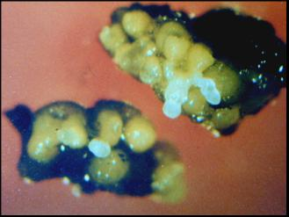
Somatic Embryogenesis
The formation of adventitious embryos
The production of embryos from somatic or “non-germ” cells.
It usually involves a callus intermediate stage which can result in variation among seedlings
https://www.youtube.com/watch?v=BiIw0TqkH7c&t=518s

Slide 47
Various terms for non-zygotic embryos
Adventious embryos
Somatic embryos arising directly from other organs or embryos.
Parthenogenetic embryos (apomixis)
Somatic embryos are formed by the unfertilized egg.
Androgenetic embryos
Somatic embryos are formed by the male gametophyte.

Slide 48
Somatic Embryogenesis and Organogenesis
Both of these technologies can be used as methods of micropropagation.
It is not always desirable because they may not always result in populations of identical plants.
The most beneficial use of somatic embryogenesis and organogenesis is in the production of whole plants from a single cell (or a few cells).

Slide 49
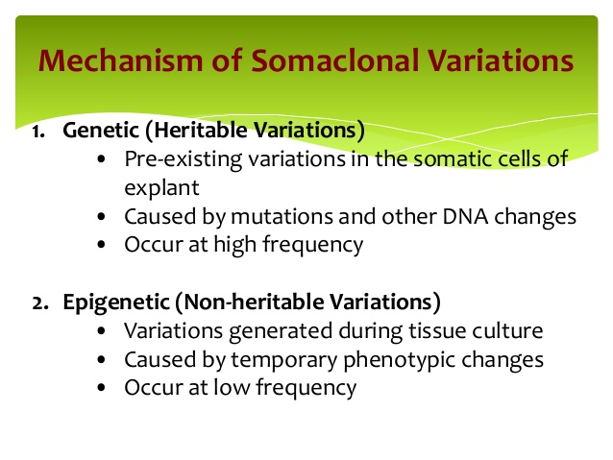

Slide 50
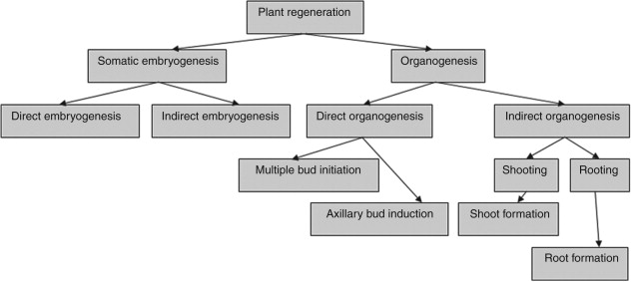

Slide 51
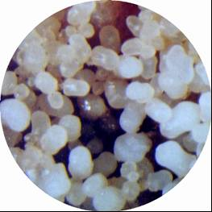
Somatic embryogenesis differs from organogenesis
Bipolar structure with a closed radicular end rather than a monopolar structure.
The embryo arises from a single cell and has no vascular connection with the mother tissue.

Slide 52
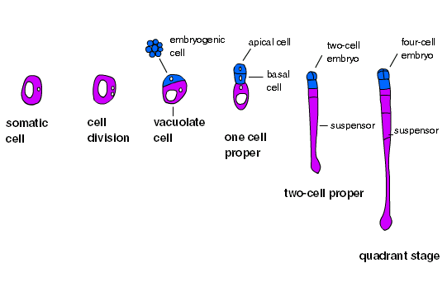

Slide 53
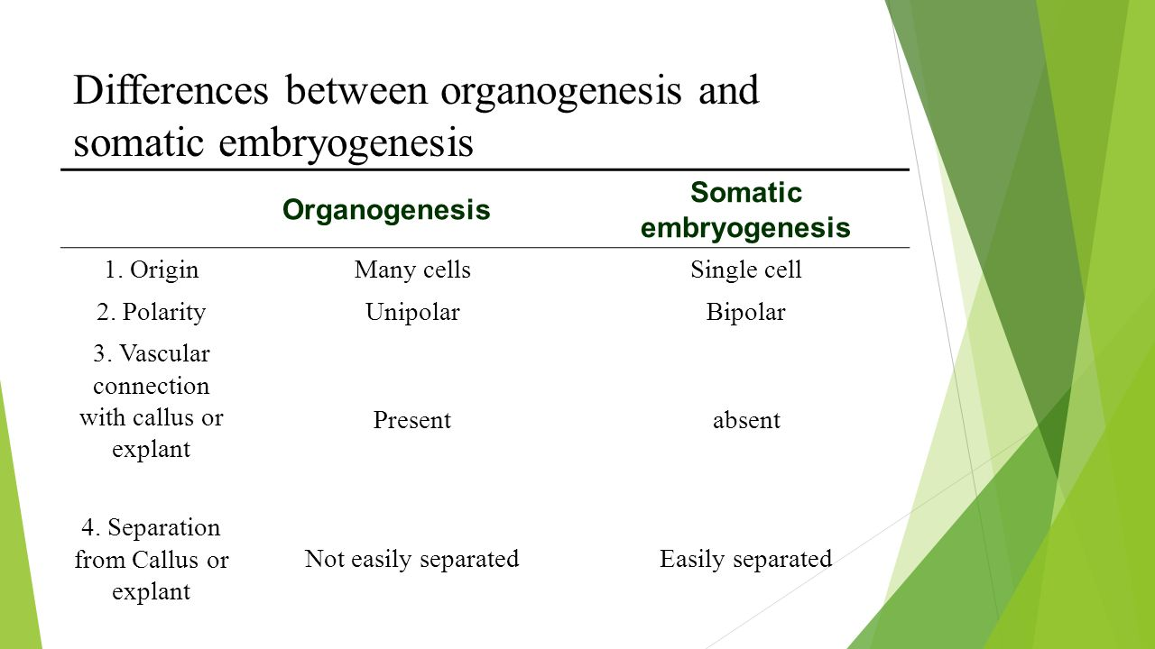

Slide 54
Two routes to somatic embryogenesis (Sharp et al., 1980)
Direct embryogenesis
Embryos initiate directly from explant in the absence of callus formation.
Indirect embryogenesis
Callus from explant takes place from which embryos are developed.

Slide 55
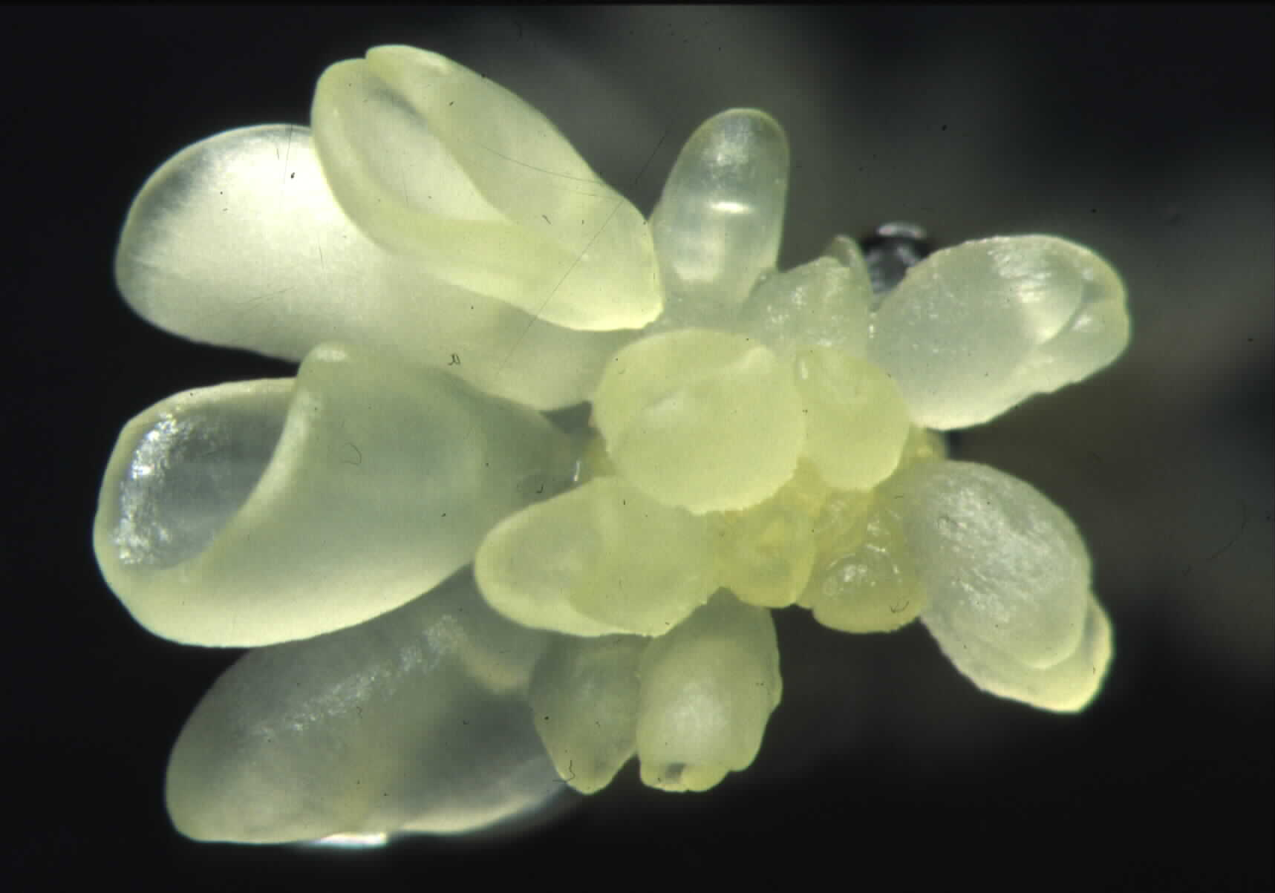
Direct somatic embryogenesis
Direct embryo formation from an explant

Slide 56
Indirect Somatic Embryogenesis
Explant → Callus Embryogenic → Maturation → Germination
Callus induction
Callus embryogenic development
Maturation
Germination

Slide 57
Induction
Auxins required for induction
Proembryogenic masses form
2,4-D most used
NAA, dicamba also used

Slide 58
Development
Auxin must be removed for embryo development
Continued use of auxin inhibits embryogenesis
Stages are similar to those of zygotic embryogenesis
Globular
Heart
Torpedo
Cotyledonary
Germination (conversion)

Slide 59
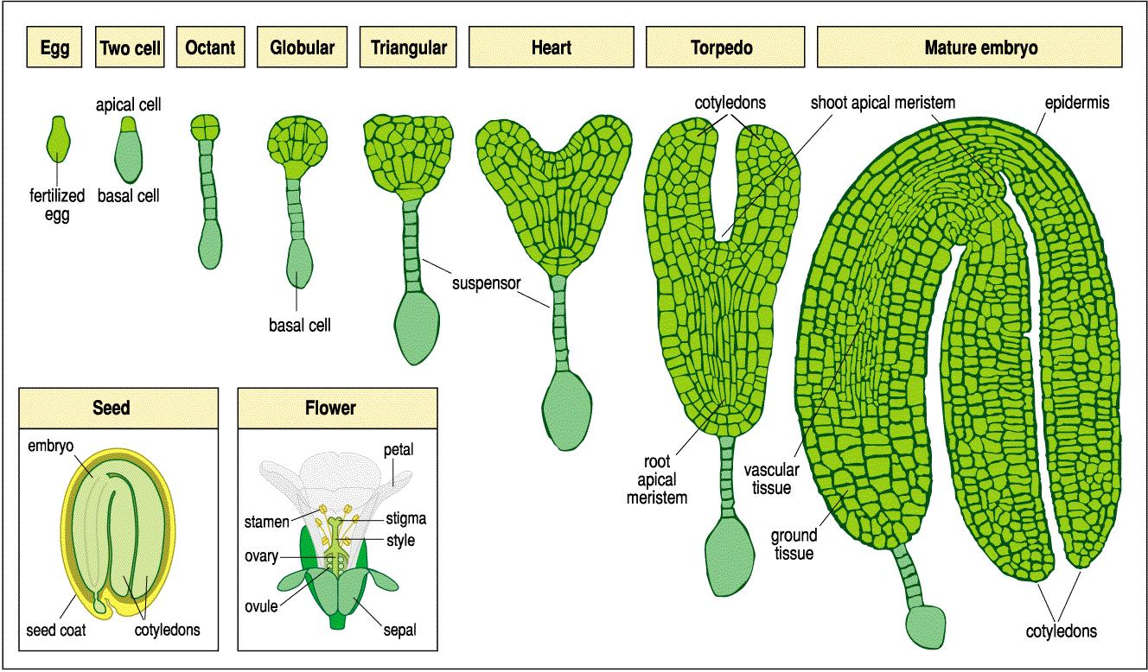

Slide 60
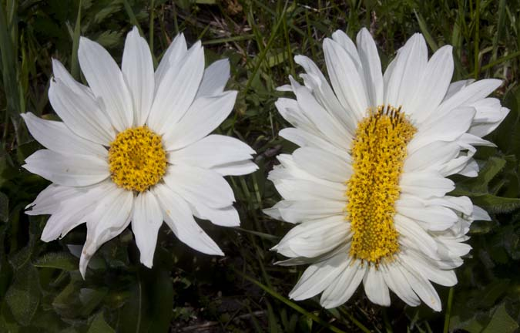
Maturation
Require complete maturation with apical meristem, radicle, and cotyledons
Often obtain repetitive embryony
Storage protein production necessary
Often require ABA for complete maturation
ABA often required for normal embryo morphology
Fasciation
Precocious germination

Slide 61
Germination
May only obtain 3-5% germination
Sucrose (10%), mannitol (4%) may be required
Drying (desiccation)
ABA levels decrease
Woody plants
Final moisture content 10-40%
Chilling
Decreases ABA levels
Woody plants

Slide 62
Types of embryogenic cells
Pre-embryogenic determined cells, PEDCs
The cells are committed to embryonic development and need only to be released. Such cells are found in embryonic tissue.
Induced embryogenic determined cells, IEDCs
In majority of cases embryogenesis is through indirect method.
Specific growth regulator concentrations and/or cultural conditions are required for initiation of callus and then redetermination of these cells into the embryogenic pattern of development.

Slide 63
Somatic embryogenesis as a means of propagation is seldom used
High probability of mutations
The method is usually rather difficult.
Losing regenerative capacity become greater with repeated subculture
Induction of embryogenesis is very difficult with many plant species.
A deep dormancy often occurs with somatic embryogenesis

Slide 64
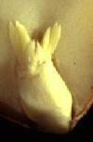
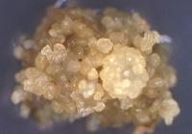
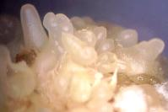
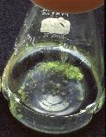
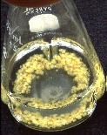
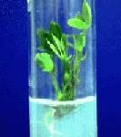
Peanut somatic embryogenesis

Slide 65
Microcutting propagation
It involves the production of shoots from pre-existing meristems only.
Requires breaking apical dominance
This is a specialized form of organogenesis

Slide 66
Steps of Micropropagation
Stage 0 – Selection & preparation of the mother plant
sterilization of the plant tissue takes place
Stage I - Initiation of culture
explant placed into growth media
Stage II - Multiplication
explant transferred to shoot media; shoots can be constantly divided
Stage III - Rooting
explant transferred to root media
Stage IV - Transfer to soil
explant returned to soil; hardened off

